Slide 1
Classifying ED visits with an LLM
MIMIC-IV-ED DEMO TRIAGE RECORDS
Self-Learning Tutorial
AI in Healthcare
Built with Python, Ollama (qwen2.5:3b) and Pydantic
Notes:
The notebook and data are at https://github.com/bja2376/triage-llm-tutorial This tutorial shows how to run a small language model on your own laptop and use it to guess the diagnosis category for an emergency department visit from the triage record alone. We compare three prompting techniques on the same visits and score each one against the diagnosis the ED actually recorded. Everything uses the open MIMIC-IV-ED demo, so you can rebuild it end to end without a PhysioNet account.

Slide 2
Clinicians get a triage record in minutes but the diagnosis comes hours later and clinicians must rehash old facts
THE PROBLEM
An LLM that drafts the diagnosis category at triage could support the clinician rather than replace them
What a triage record looks like
What the ED recorded later
Age 83, female. Arrived by ambulance.
Chief complaint: "Syncope, Transfer"
T 97.7°F, HR 74, RR 20, SpO2 96%,
BP 133/65. Pain 3/10. ESI acuity 2.
Primary diagnosis (seq_num = 1)
R55, Syncope and collapse
We score the model against the ICD-10 chapter of this diagnosis, which here is "Symptoms & signs".
The model sees the complaint, vitals, pain, acuity, arrival, age and sex.
Notebook cell 15
2
Notes:
This slide sets up the question the tutorial tries to answer. A triage record is the first structured note in an ED visit, and it holds the chief complaint, vitals, pain score, arrival mode and ESI acuity, where 1 is the most urgent and 5 the least. The diagnosis on the right is only recorded hours later, after labs, imaging and an exam. A draft category at triage could help a clinician think ahead or route the case, but it is a suggestion to check and never a replacement for clinical judgment. The record shown is one real stay from the demo data.

Slide 3
This tutorial walks through seven steps beginning with a raw triage table and concluding with a scored LLM
WHAT YOU WILL LEARN
By the end you will be able to run an LLM locally on MIMIC data, prompt it three ways and measure whether the prompting helped
You will learn how to
The seven steps
Run an open-weight LLM on your own laptop with Ollama, so patient records never leave the machine.
Set up a local model with Ollama
Build the cohort from five demo tables
Group each diagnosis into an ICD-10 chapter
Turn each triage row into a text prompt
Ask the model with three prompting techniques
Score the answers by chapter
Read the results and their limits
Turn a row of MIMIC-IV-ED data into a prompt and get structured JSON back.
Compare zero-shot, few-shot and chain-of-thought prompting against real ED diagnoses.
3
Notes:
This is the plan for the rest of the tutorial. Each of the seven steps matches a numbered section of the notebook, so you can follow along cell by cell. Steps 1 through 4 set up the model and prepare the data. Step 5 is where the LLM work happens, so it gets four slides. Steps 6 and 7 score the answers and read the results. The aim is to leave with a workflow you can reuse on other MIMIC tables, not just a single accuracy number.

Slide 4
Module 13 provided an overview of prompting techniques and this tutorial tests them on real ED visits
WHAT THIS BUILDS ON
Every technique comes from the course, while the MIMIC-IV-ED tables and the measured accuracy are new
From the course
New here
The course covered zero-shot, few-shot and chain-of-thought prompting and showed how to check JSON output with Pydantic.
This tutorial applies them to MIMIC-IV-ED triage records, uses real ED diagnoses as labels and measures how accurate each technique is.
4
Notes:
This slide shows how the tutorial extends the course rather than repeating it. From the course - Zero-shot, few-shot and chain-of-thought prompting (Module 13, Practices 1–2) - Checking JSON output with Pydantic (Practice 2) New here - The MIMIC-IV-ED triage table, which the course did not use - Measuring whether each technique actually helps

Slide 5
Before step 1, get the code onto your machine and give it its own Python environment
BEFORE YOU START (1 OF 2)
The demo data is already in the repo, so you don't need a PhysioNet account to follow along
1. Clone the repo
YOU SHOULD SEE
git clone https://github.com/bja2376/triage-llm-tutorial.git
cd triage-llm-tutorial
After cloning, the folder holds the data and the notebook.
2. Make and activate a virtual environment
data/
triage_llm_tutorial.ipynb
triage_llm_tutorial.pdf
python -m venv .venv
source .venv/bin/activate # macOS or Linux
.venv\Scripts\activate # Windows
Once the environment is active, your terminal prompt starts with (.venv).
3. Install Jupyter and open the notebook
Jupyter then opens the notebook in your browser.
pip install jupyter
jupyter notebook triage_llm_tutorial.ipynb
Notebook section "Before you start"
5
Notes:
This slide gets the code and a clean Python environment onto your machine, and the next slide covers Ollama. You need git and Python 3 installed first. The demo CSVs are already committed under data because their open license allows it, so cloning is the only download. Make the virtual environment inside the repo folder so the notebook installs its packages there. If you use uv instead of venv, add --seed, because otherwise the environment has no pip and the install cell fails. In VS Code, open the repo folder and choose the .venv kernel.

Slide 6
Then install Ollama, which runs the model on your laptop, and run the whole notebook
BEFORE YOU START (2 OF 2)
Ollama has to be running before you start the notebook, because the setup cell asks it to download the model
4. Install Ollama
YOU SHOULD SEE
On macOS or Windows, download the installer from ollama.com/download and open the app. On Linux, run
ollama --version prints a version number, and the pull ends with
curl -fsSL https://ollama.com/install.sh | sh
success
5. Check that it works
The full run takes about 10 minutes on a laptop. Each code cell opens with a comment that says what it should print, so you can check every step against it.
ollama --version
ollama pull qwen2.5:3b # optional, the notebook does this too
6. Run every cell
In Jupyter, open the Run menu and choose Run All Cells. Keep Ollama open until the last cell finishes.
Notebook section "Before you start" and cell 4
6
Notes:
Ollama is the program that runs the model on your laptop, and the notebook talks to it through the ollama Python package. On macOS and Windows the installer runs Ollama in the background as an app, and on Linux the install script sets it up as a service. Pulling the model ahead of time is optional, but it lets you watch the 2 GB download finish before you start. A full run takes about 10 minutes, mostly for chain-of-thought. If anything hangs, check that the Ollama app is still running.

Slide 7
First, run a small open model locally so no patient record leaves the machine
SETUP (STEP 1 OF 7)
A 3B model answers in about 2.3 seconds per call on a laptop, which is fast enough to score every stay in a reasonable amount of time
The config cell
YOU SHOULD SEE
MODEL = "qwen2.5:3b" # served by Ollama
N_CASES = 1000 # lower = faster
SEED = 42
DATA = Path("data")
print("pull:", ollama.pull(MODEL).status)
print(ollama.show(MODEL).details)
pull: success
family='qwen2'
parameter_size='3.1B'
quantization_level='Q4_K_M'
2.3s per call
The full run takes roughly the per-call time multiplied by 3 prompts and by N_CASES.
One timed test call
r = ollama.chat(model=MODEL, messages=[{"role": "user",
"content": "Name one ICD-10 chapter."}],
options={"temperature": 0, "seed": SEED})
Notebook cells 3–5
7
Notes:
We run a small open model locally because the MIMIC data use agreement does not allow sending records to an outside API like ChatGPT. Because of that, the same code would also work on the full credentialed data. The config cell is the one place to change settings. MODEL picks the model, N_CASES caps how many stays are scored and SEED keeps runs repeatable. The printed details and digest let a peer confirm they pulled the same weights. If the pull hangs, check that the Ollama app is running.

Slide 8
Next, we join five demo tables into one row per ED stay and keep only the fields known at triage
DATA (STEP 2 OF 7)
The cohort has 221 stays from 63 patients, and we leave out anything recorded after the diagnosis so the answer doesn't leak into the prompt
Load the tables and build the cohort
YOU SHOULD SEE
edstays = pd.read_csv(DATA / "ed/edstays.csv.gz")
triage = pd.read_csv(DATA / "ed/triage.csv.gz")
diagnosis = pd.read_csv(DATA / "ed/diagnosis.csv.gz")
patients = pd.read_csv(DATA / "hosp/patients.csv.gz")
d_icd = pd.read_csv(DATA / "hosp/d_icd_diagnoses.csv.gz")
primary = diagnosis[diagnosis.seq_num == 1]
cohort = (edstays
.merge(triage, on="stay_id")
.merge(patients, on="subject_id")
.merge(primary, on="stay_id"))
222 ED stays → 221 with triage + primary diagnosis (63 patients)
table | used for
edstays | sex, arrival transport
triage | complaint, vitals, pain, acuity
diagnosis | the label (seq_num = 1)
patients | age (anchor_age)
d_icd_diagnoses | checking codes in step 6
Notebook cells 7–9
8
Notes:
This step builds one row per ED stay from five demo tables. Fields known at triage go beyond the triage table, so sex and arrival transport come from edstays and age comes from patients. The label is the primary diagnosis, which is the one with seq_num 1. We drop disposition, outtime, hadm_id and the other diagnoses, because they are recorded after the diagnosis and would leak the answer. Age is approximate, since anchor_age is the patient's age in their anchor year. The join on the slide leaves out the column lists, which the notebook includes.

Slide 9
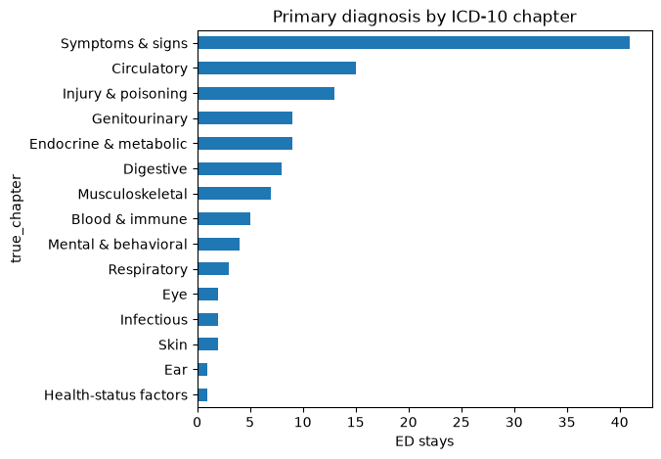
Then group each diagnosis into one of 22 ICD-10 chapters so the task is answerable
LABELS (STEP 3 OF 7)
About a third of stays are coded as "Symptoms & signs", which sets the baseline that any prompt has to beat
Map each code to its chapter
YOU SHOULD SEE
ICD10_CHAPTERS = [
("A00", "B99", "Infectious"),
# ... 22 chapters in all
("R00", "R99", "Symptoms & signs"),
("S00", "T88", "Injury & poisoning"), ...]
def icd10_chapter(code):
category = clean_code(code)[:3]
for lo, hi, name in ICD10_CHAPTERS:
if lo <= category <= hi:
return name
return "Unknown"
Dropped 99 ICD-9 stays → 122 ICD-10 stays
Notebook cells 11–13
9
Notes:
We score at the ICD-10 chapter level because an exact code is too fine-grained to guess from a triage record. The 22 chapters match the grouping from lecture 4.1 and Series 11. The function takes the first three characters of a code and finds the chapter whose range contains them, and the notebook version also rejects malformed codes. We keep only ICD-10 stays because the model answers in ICD-10. Notice that Symptoms & signs is about a third of the stays, which is the baseline to remember when we read the accuracy later.

Slide 10
Each triage row becomes a short text summary that the model can read rather than a dataframe
PROMPT (STEP 4 OF 7)
Missing values are written as "not recorded" instead of "nan" so that blanks don't confuse the model
Turn a row into text
YOU SHOULD SEE
def show(x, unit=""):
return "not recorded" if pd.isna(x) else f"{x}{unit}"
def make_prompt(row) -> str:
sex = {"M": "male", "F": "female"}.get(row.gender,
"sex not recorded")
return (f"Age {row.anchor_age}, {sex}. "
f"Arrived by {show(row.arrival_transport).lower()}.\n"
f'Chief complaint: "{show(row.chiefcomplaint)}"\n'
f"Triage vitals: T {show(row.temperature, '°F')}, "
f"HR {show(row.heartrate)}, RR {show(row.resprate)}, "
f"SpO2 {show(row.o2sat, '%')}, "
f"BP {show(row.sbp)}/{show(row.dbp)}. "
f"Pain {show(row.pain)}/10. "
f"ESI acuity {show(row.acuity)}.")
Age 83, female. Arrived by ambulance.
Chief complaint: "Syncope, Transfer"
Triage vitals: T 97.7°F, HR 74.0, RR 20.0, SpO2 96.0%, BP 133.0/65.0. Pain 3/10. ESI acuity 2.0.
The test cell after it should print "prompt tests pass".
Notebook cells 15–16
10
Notes:
This step turns each triage row into a few lines of text, which is the table-to-prompt idea from the CancerGPT paper in Module 13. The show helper writes "not recorded" for any missing value, because a raw "nan" means nothing to the model. The test cell after it builds a row with a missing temperature and checks that "nan" never appears. The same function builds every prompt in step 5, so the technique is the only thing that changes. Long lines on the slide are wrapped to fit.

Slide 11
Before running it, here is how the three prompting techniques differ
ASK THE MODEL (STEP 5 OF 7)
Each technique changes only what the model sees before the question, so their scores can be compared directly
Zero-shot
Few-shot
Chain-of-thought
The model gets the instruction and the triage summary and nothing else.
The model first sees three solved stays as earlier turns in the chat, and then the new stay.
This is zero-shot with an added "think step by step", and the model writes its reasoning before its answer.
This is the baseline, because it shows what the model knows on its own.
The examples show it the answer format and the kind of diagnosis the ED records.
Reasoning first can help large models work through a problem, but it also takes longer.
11
Notes:
This slide explains the three techniques before we look at the code. All three share one system instruction that asks for the most likely ED diagnosis and its ICD-10 code in JSON. Zero-shot sends only the triage summary. Few-shot adds three solved stays as earlier chat turns. Chain-of-thought asks the model to reason step by step before answering. Each one is compared against zero-shot rather than stacked, so any change in score can be traced to one technique. All three come from Module 13 and Practices 1 and 2.

Slide 12
Few-shot examples are picked by a fixed rule, and their patients are kept out of scoring
ASK THE MODEL (STEP 5 OF 7)
This keeps the comparison fair, because the model is never scored on a patient it has already been shown
Pick the examples and the evaluation set
YOU SHOULD SEE
top3 = cohort.true_chapter.value_counts().index[:3]
examples = (cohort[cohort.true_chapter.isin(top3)]
.sort_values("stay_id").groupby("true_chapter").head(1))
eval_df = cohort[~cohort.subject_id.isin(examples.subject_id)]
eval_df = eval_df.sample(n=min(N_CASES, len(eval_df)),
random_state=SEED)
print(examples[["stay_id", "chiefcomplaint",
"icd_code", "true_chapter"]])
print(f"Evaluating on {len(eval_df)} stays from "
f"{eval_df.subject_id.nunique()} patients")
Fatigue, s/p Fall R531
MVC/INTUBATED TRAUMA S066X9A
Transfer I313
Evaluating on 94 stays
from 29 patients
The three examples come from the Symptoms, Injury and Circulatory chapters.
Notebook cell 19
12
Notes:
This cell picks the three few-shot examples by a fixed rule, taking the first stay from each of the three most common chapters, so anyone who reruns it gets the same examples. It then removes every stay from those three patients, not just the example stays, so the model is never scored on a patient it has already seen. That leaves 94 stays from 29 patients. If your counts differ, check that you did not change N_CASES or SEED. Long lines on the slide are wrapped to fit.

Slide 13
One function builds every prompt, so the only difference between techniques is the messages it adds
ASK THE MODEL (STEP 5 OF 7)
Few-shot adds three solved examples as earlier chat turns, chain-of-thought adds one sentence and zero-shot adds nothing
Build the messages
YOU SHOULD SEE
def build_messages(row, technique: str) -> list[dict]:
msgs = [{"role": "system", "content": SYSTEM}]
if technique == "few_shot":
for _, ex in examples.iterrows():
msgs.append({"role": "user", "content": make_prompt(ex)})
msgs.append({"role": "assistant", "content":
Answer(diagnosis=ex.icd_title,
icd10=ex.icd_code).model_dump_json()})
user = make_prompt(row) + (COT_HINT if technique == "cot" else "")
msgs.append({"role": "user", "content": user})
return msgs
Printing the roles of one few-shot prompt gives eight messages.
system
user, assistant # example 1
user, assistant # example 2
user, assistant # example 3
user # the new stay
Zero-shot and chain-of-thought prompts have only two, the system message and the new stay.
Notebook cell 18
13
Notes:
This one function builds every prompt, which keeps the comparison clean. Every technique starts with the same system message. Few-shot adds each example as a user turn with its triage summary and an assistant turn with the real ED answer in our JSON format. Chain-of-thought adds one sentence asking the model to reason first, and zero-shot adds nothing. The notebook does not print the roles, but you can check them with [m["role"] for m in build_messages(eval_df.iloc[0], "few_shot")]. Long lines on the slide are wrapped to fit.

Slide 14
One function sends each prompt to Ollama and checks the answer against a Pydantic schema
ASK THE MODEL (STEP 5 OF 7)
Passing the schema to format= makes the model return JSON, and any answer that fails to parse is counted as wrong
Ask and validate
YOU SHOULD SEE
def ask(row, technique: str):
schema = AnswerCoT if technique == "cot" else Answer
resp = ollama.chat(model=MODEL,
messages=build_messages(row, technique),
format=schema.model_json_schema(),
options={"temperature": 0, "seed": SEED,
"num_predict": 512})
try:
a = schema.model_validate_json(resp.message.content)
return (a.diagnosis, a.icd10,
getattr(a, "reasoning", None), True)
except ValidationError:
return None, None, None, False
few_shot ('Corneal ulcer of eye, unspecified', 'H56.1', None, True)
The answer schemas
class Answer(BaseModel):
diagnosis: str
icd10: str
class AnswerCoT(BaseModel):
reasoning: str
diagnosis: str
icd10: str
Notebook cells 18 and 20
14
Notes:
This function sends one prompt to the local model and checks the reply. Passing the Pydantic schema to format= makes Ollama return JSON in that shape, and Pydantic then validates it, as in Practice 2. The chain-of-thought schema puts reasoning first, so the model writes it before committing to an answer. Temperature 0 and a fixed seed keep answers repeatable, and num_predict caps the length because small models can loop in JSON mode. An answer that fails to validate is counted as wrong rather than dropped.

Slide 15
The full run asks all three prompts about the same 94 stays, which takes about 10 minutes
ASK THE MODEL (STEP 5 OF 7)
Chain-of-thought takes about five times longer than the other two because it writes out its reasoning first
Run every stay through every technique
YOU SHOULD SEE
TECHNIQUES = ["zero_shot", "few_shot", "cot"]
rows = []
for technique in TECHNIQUES:
for _, row in tqdm(eval_df.iterrows(), total=len(eval_df),
desc=technique):
dx, code, reasoning, ok = ask(row, technique)
rows.append({"stay_id": row.stay_id,
"technique": technique,
"true_chapter": row.true_chapter,
"pred_code": code,
"parse_ok": ok})
results = pd.DataFrame(rows)
zero_shot: 100% 94/94 [01:25]
few_shot: 100% 94/94 [01:04]
cot: 100% 94/94 [06:56]
Three progress bars appear, one for each technique, followed by the first rows of the results table.
If the run is too slow on your machine, lower N_CASES in the config cell and run it again.
Notebook cell 21
15
Notes:
This loop runs every technique over the same 94 stays in the same order, which is what makes the accuracies comparable. It stores one row per answer, so the results table ends up with 282 rows. Zero-shot and few-shot take about a minute each, and chain-of-thought takes about seven because it writes a paragraph before every answer. The notebook keeps more columns than the slide shows, including the reasoning, which helps when you want to read individual mistakes.

Slide 16
Each answer is scored by its ICD-10 chapter and checked against the code dictionary
SCORE (STEP 6 OF 7)
Accuracy and the invented-code rate are measured separately, because a made-up code can still land in the right chapter
Score each prompt
YOU SHOULD SEE
results["pred_chapter"] = results.pred_code.map(
lambda c: icd10_chapter(c) if isinstance(c, str)
else "Parse failed")
results["correct"] = results.pred_chapter == results.true_chapter
results["valid_code"] = results.pred_code.map(
lambda c: clean_code(c) in valid_icd10 if isinstance(c, str)
else np.nan).astype(float)
summary = results.groupby("technique", sort=False).agg(
accuracy=("correct", "mean"),
invented_code=("valid_code", lambda v: 1 - v.mean()),
parse_failed=("parse_ok", lambda v: 1 - v.mean()))
technique | acc. | invented | parse
zero_shot | 31% | 49% | 0%
few_shot | 30% | 43% | 0%
cot | 24% | 60% | 5%
The next slide reads these numbers alongside the notebook's charts.
Notebook cell 23
16
Notes:
This cell turns the raw answers into three numbers per technique. Each predicted code is mapped to a chapter with the same function from step 3, and an answer that failed to parse counts as wrong. Each code is also checked against the ICD-10 dictionary, which is the hallucination check from Practices 1 and 3. A model can invent a code like R07.99 that still lands in the right chapter, which is why invented codes are measured separately. The charts on the next slide come from cells 24 and 25.

Slide 17
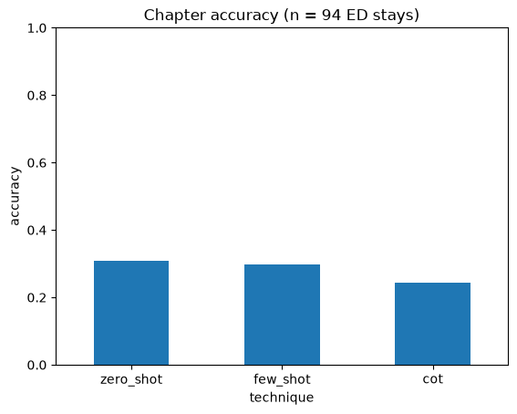
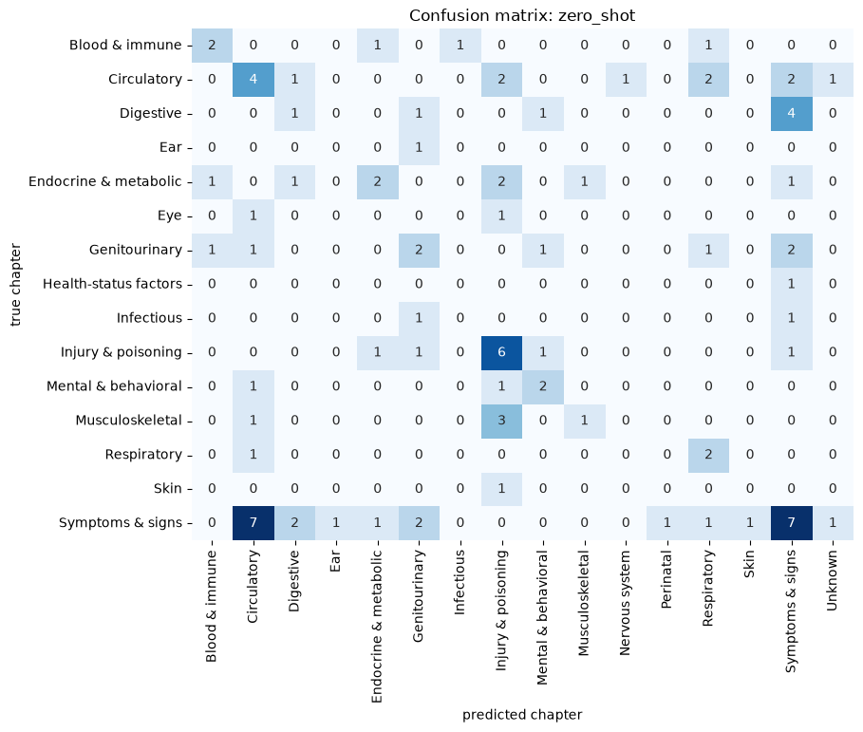
None of the techniques clearly beat zero-shot, and chain-of-thought did worst
RESULTS (STEP 7 OF 7)
Adding examples didn't make the model more accurate, and the ±10-point noise is larger than any gap between the prompts
 | Zero | Few | CoT
Accuracy | 31% | 30% | 24%
Invented code | 49% | 43% | 60%
Parse failed | 0% | 0% | 5%
Few-shot invented fewer codes, which suggests the examples teach the code format more than the diagnosis.
The most common error is 7 "Symptoms" stays that the model labeled "Circulatory" because the ED coded only the symptom.
Notebook cells 23–25
17
Notes:
Zero-shot reached 31% chapter accuracy, few-shot 30% and chain-of-thought 24%. For context, random guessing among 22 chapters scores under 5%, and always guessing Symptoms & signs scores about 26%. So the model learned something from the triage text, but it only edges past the simplest baseline, and with 94 stays the 95% interval is about ±10 points. Few-shot cut invented codes from 49% to 43%, which suggests the examples teach the format more than the diagnosis. My reading is that the triage record itself limits accuracy, which a larger sample could test. The confusion matrix is for zero-shot, and its biggest error is 7 Symptoms stays labeled Circulatory.

Slide 18
These results are only a first look because the labels are imperfect and both the sample and the model are small
LIMITATIONS AND RESPONSIBLE USE (STEP 7 OF 7)
This should only be used as decision support, where a clinician reviews the draft so that automation bias doesn't creep in
Billing labels
Small sample
One hospital
The codes are assigned after the workup and are not a gold standard, and they often record only the symptom.
We scored only 94 stays from 29 patients, so the estimates are noisy.
All of the data comes from Beth Israel Deaconess, and its coding habits may not carry over to other hospitals.
One small model
Unfaithful reasoning
Decision support only
We used a single 3B, 4-bit model with one seed, and a larger model may behave differently.
The CoT reasoning sounds plausible, but it can invent findings or answer in ICD-9.
A tool like this should never replace triage judgment (lectures 10.2 and 8.2).
18
Notes:
The accuracy is low, and part of that comes from the labels. The ED records a billing code after the workup, and when it cannot confirm a cause it records only the symptom, so a reasonable answer can still count as wrong. As lectures 10.2 and 8.2 discuss, a tool like this could only draft a chapter for a clinician to check, with human review to guard against automation bias. Natural next steps are more cases from the credentialed data, a larger local model, other MIMIC-IV-ED tables such as medrecon, or giving the model an ICD-10 lookup.

Slide 19
Data, tools and papers used in this tutorial
REFERENCES
Data
Models, tools and papers
Johnson, A., Bulgarelli, L., Pollard, T., Celi, L. A., Horng, S., & Mark, R. (2023). MIMIC-IV-ED Demo (version 2.2). PhysioNet. https://doi.org/10.13026/jzz5-vs76
Qwen Team. Qwen2.5 Technical Report. arXiv 2412.15115, 2024.
Ollama, ollama.com, for running the model locally, and Pydantic, docs.pydantic.dev, for validating the JSON answers.
Johnson, A., Bulgarelli, L., Pollard, T., Horng, S., Celi, L. A., & Mark, R. (2022). MIMIC-IV Clinical Database Demo. PhysioNet. https://doi.org/10.13026/ng9m-3n32
Li T, et al. CancerGPT for few shot drug pair synergy prediction using large pretrained language models. npj Digital Medicine, 2024.
Pollard, T., Moody, B. E., Lehman, L., Gow, B., Fernandes, C., Xie, C., Johnson, A., Mark, R. G., & Heldt, T. (2026). PhysioNet as a global platform for biomedical research. Nature Health. https://doi.org/10.1038/s44360-026-00096-z
Course Module 13 (prompting) and Practices 1–3, lectures 2.2, 4.1, 8.2 and 10.2, and Series 9 and 11.
19
Notes:
These are the sources for the data, the model and the methods. The demo data is openly licensed, which is why it can be committed to the repo. Even with temperature 0 and a fixed seed, LLM output can vary slightly across hardware and Ollama versions, so a peer's numbers may not match these exactly. The overall pattern should hold.

